Slide 5


Slide 6


Slide 7


Slide 8
Column alias scope
A column alias is a temporary name for a columns. It is declared in the SELECT clause:
SELECT expression AS column_alias
Column aliases are only in scope for the ORDER BY, GROUP BY, and HAVING clauses
The following use of total_credits in an ORDER BY clause is correct
SELECT
credit_total + payment_total AS total_credits
FROM invoices
ORDER BY total_credits DESC

Slide 9
Column alias scope
The following use of a column alias in SELECT and WHERE clauses is erroneous
SELECT
credit_total + payment_total AS total_credits,
total_credits * 0.5 AS half_total_credits
FROM invoices
Error Code: 1054. Unknown column 'total_credits' in 'field list‘
SELECT
credit_total + payment_total AS total_credits
FROM invoices
WHERE total_credits < 100
Error Code: 1054. Unknown column 'total_credits' in 'where clause'

Slide 10
Column alias scope
The query processing order is:
1. FROM 2. WHERE 3. GROUP BY 4. HAVING 5. SELECT -- column aliases created here 6. ORDER BY
ORDER BY can use column aliases because they are created in SELECT before ORDER BY is processed
MySQL extends the functionality of GROUP BY and HAVING so they can also use column aliases like ORDER BY

Slide 11


Slide 12


Slide 13
SELECT DISTINCT
vendor_city, vendor_state, vendor_id
FROM
vendors
ORDER BY vendor_city , vendor_state;

Slide 16
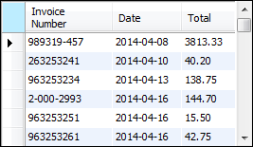

Slide 17
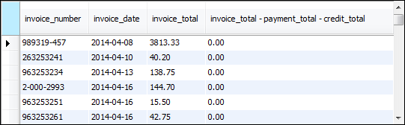

Slide 19


Slide 20


Slide 21


Slide 23


Slide 24

SELECT
vendor_name,
CONCAT(vendor_city, ', ',vendor_state, ' ' ,vendor_zip_code) as address
WHERE
CONCAT(vendor_city, ', ',vendor_state, ' ',vendor_zip_code) = 'Anaheim, CA 92807'
ORDER BY
address;

Slide 25


Slide 27


Slide 28

See page 261 of book for more date format strings

Slide 29


Slide 30


Slide 31


Slide 32


Slide 33


Slide 34
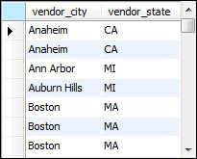

Slide 35
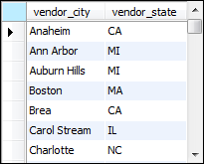

Slide 40


Slide 41


Slide 44
zero or more characters
a single character

Slide 50
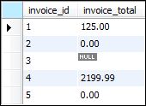

Slide 51



Slide 52

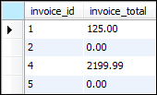

Slide 53
drop procedure if exists MyIsNull;
delimiter //
create procedure MyIsNull(param1 float)
begin
if (param1 is null) then
select param1, true as 'param1 is null';
else
select param1, false as 'param is null';
end if;
end //
delimiter ;
call MyIsNull(10);
call MyIsNull(null);
-- try with if(param1 = null) and if(param1 != null)

Slide 54
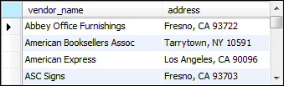

Slide 56
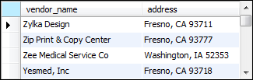

Slide 57
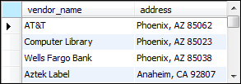

Slide 58
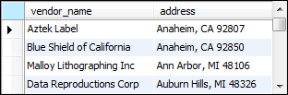

Slide 59
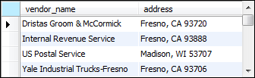

Slide 60


Slide 61
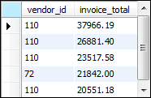

Slide 62


Slide 63
